Slide 1
Active Directory Fundamentals Section 1 - Active Directory From Scratch
AD
Notes:
“Active Directory from zero to hero”
The ambitious goal of this module is to educate IT students in order for them to fully understand the main components of Active Directory without prior knowledge of the technology.
[IMPORTANT: This slide deck is intended to be used in a PDF format to ensure the students read both the slides and the notes sections. The video placeholders refer to the videos shown during the recorded video/demo parts of this training.]

Slide 2
Foreword
This deck contains some design artefacts which all have their importance…
This sticky note icon is used to introduce the abbreviation of a concept or a technical word. Once the abbreviation has been introduced, the full version is no longer mentioned.
You will also find a list of all abbreviations at the end of the deck.
We were all young once. A section with this icon will basically tell you the history you might have missed by not working with the technology for the last 20 years.
It is not because you are new that you don’t have to know how we got here!
Professor Useful will introduce some tricky technical details which might not seem relevant at first but could end up being really useful if you want to dig deeper in the technology.
Abbr.
This frame contains…
Takeaways so important that we framed them
Notes:
This slide deck is just a part of the cursus. The entire cursus includes:
the training videos
these decks (slides and notes sections)
a list of required external documents

Slide 3
Agenda
01
07
Introduction An overview of the Active Directory Domain Services
Storage Overview of the physical components of the database.
02
08
Components and terminology Review of the different components and the technical terms.
DC locator Overview of the process by which a machine finds a domain controller.
03
09
Objects and naming contexts Review of the different types of objects and logical structures of the database.
Group policies Introduction to the group policy infrastructure.
04
10
Permissions and security An explanation of the default security mechanisms.
Removal process Overview of the decommission process.
05
LDAP Introduction to the LDAP service in AD DS.
06
Replication Description of the multi-master replication model.

Slide 4
.
Video
Video Placeholder
This slide has to be watched with PowerPoint
Notes:
During this video you can see:
The user Alice trying to open a session on her workstation
Before typing her username and password, she reads a warning message about the company’s security policies
Once she typed her password, she is prompted to update her password
She does but the new one does not match the password policy, she has to try another one
Once connected, we can see the company's logo in the wallpaper
She clicks on the Start menu and we can see her display name
Now, she connects to a file share with SSO
She tries to open a file but she gets a custom access denied message
She finally open her Word document

Slide 5
What did we just see?
A user opening an interactive session on a Windows machine
The user is even prompted to change its password according to a specific policy
The user environment is customized (warning messages, display name, custom desktop…)
A user accessing a file share somewhere on the network
The user is not prompted for password, single sign-on
The user does not have access to all the files
SSO
This whole world is managed by Active Directory
Authentication (users and systems, SSO)
Identity management (information and authorization)
System management (security policies, customizations)
Notes:
Many different mechanisms took place behind the scene. One of the objectives of the module is to understand those different components and later explain how to secure them.

Slide 6
Let’s clarify what we are talking about…
Active Directory what?
Active Directory Domain Services
Active Directory Lightweight Directory Services
Active Directory Certificate Services
Active Directory Federation Services
Active Directory Right Management Services
It’s a Windows role
No need for a specific license
In the Windows world: OS role ≠ feature
Well, it’s AD…
Notes:
What is what then?
Active Directory Domain Services stores directory data and manages communication between users and domains, including user logon processes, authentication, and directory searches. AD DS is the central location for configuration information, authentication requests, and information about all of the objects that are stored within your forest.
Active Directory Lightweight Directory Services is a Lightweight Directory Access Protocol (LDAP) directory service that provides flexible support for directory-enabled applications, without the restrictions of Active Directory Domain Services (AD DS). Instead of using your organization’s AD DS database to store the directory-enabled application data, AD LDS can be used to store the data. AD LDS can be used in conjunction with AD DS so that you can have a central location for security accounts (AD DS) and another location to support the application configuration and directory data (AD LDS).
Active Directory Certificate Services allows you to create, distribute, and manage customized public key certificates.
Active Directory Federation Services provides Web single-sign-on (SSO) technologies to authenticate a user to multiple Web applications over the life of a single online session. It implements protocols such as WS-Federation, WS-Trusts, SAMLv2, OAuth2 and OIDC.
Active Directory Right Management Services protects your information and works with AD RMS-enabled applications to help safeguard digital information from unauthorized use. AD RMS can help make sure that only those individuals who need to view a file can do so. AD RMS can protect a file by identifying the rights that a user has to the file. Rights can be configured to allow a user to open, modify, print, forward, or take other actions with the rights-managed information.
And to make it easy, most of the time, when not specified otherwise, the term AD is used in place of AD DS.

Slide 7
Misconceptions
Nothing is standard, it’s only custom…
It’s only a Windows thing!
Alright then, it’s just a big LDAP server!
Notes:
Although the majority of you have probably not interacted with AD before, you might have heard of it in the following terms. So let’s debunk the common misconceptions around it…
It’s only a Windows thing!
It is a Windows role running on a Windows Server. So from that perspective it is a Windows thing. But any applications installed on a Windows system joined to an Active Directory environment can leverage its capabilities. Even Unix systems can leverage AD through its different interfaces. Sometimes a third-party application is relying on AD for authentication only, sometimes for the storage of its configuration. For example, Oracle can store configuration information to facilitate the location of its databases: Using Oracle Database with Microsoft Active Directory https://docs.oracle.com/cd/B28359_01/win.111/b32010/active_dir.htm#BGBEIIDH. Or Cisco for its telephone system: Active Directory and Cisco CallManager Integration https://www.cisco.com/c/en/us/support/docs/voice-unified-communications/unified-communications-manager-callmanager/18653-ad-ccm-trblsht-guide.html).
Nothing is standard, it’s only custom…
You can guess it by now, AD and Windows do implement standard protocols. Kerberos for authentication, LDAP for information retrieval, NTP for time synchronization, DNS for name resolution, etc. Ok, some of them have a Microsoft twist that will be discussed in this course, but realistically, many implementations of RFC have their own set of specifications. Microsoft’s implementations of protocol (whether they are Microsoft protocols or standard implementations) are available here: Technical Documents https://msdn.microsoft.com/en-us/library/jj712081.aspx.
Alright then, it’s just a big LDAP server!
AD does talk LDAP (it understands v2 and v3). But you can’t reduce AD to its LDAP component. By doing so, you set yourself up for failure. If you think it is just an LDAP server, you might be tempted to secure it like your would secure an LDAP server. And you would miss all the other entry points and capabilities made available in the network… There are many moving parts in AD DS, and all of them have a way to be tweaked.

Slide 8
Terminology
contoso.com
A domain controller
Physical entry point
A domain
Administration and replication boundary
A forest
A security boundary
A trust
Extension of the security boundary
A site
A representation of the physical network topology
DC
contoso.com
trusts
Toronto
Paris
eu.contoso.com
fabrikam.com
Notes:
A domain controller
It hosts the database. It handles authentication requests. This is also where the systems policies and configuration files are (for example if you want to apply the same background desktop pictures to all users, the file containing this setting – not the picture itself, but the setting) is also stored on the domain controllers.
A domain
It is generally admitted that a domain is an administrative boundary. You can define admins which will have privileges only on this domain and nowhere else in the forest. It is possible to give permissions to security principals from other domains (though none are configured by default).
Later we will see how the DCs replicate. It will be the occasion to see that there is also a replication boundary. Although there is information which replicates on every domain controller in the forest, the domain stays a boundary for many types of data.
A forest
If you have no account in the forest, you have no access to its resources.
A trust
Well, you can extend who can use the resources of your forest by creating trusts.
A site
Active Directory sites are a logical representation of the physical network topology. There are two main advantages of creating sites:
Optimizing DCs replication (DCs in the same site will replicate differently than DCs in different sites)
Optimizing DCs location from clients (clients will always try to talk to the physically closest domain controllers)

Slide 9
What’s on a domain controller?
A database on the disk C:\Windows\NTDS\ntds.dit
The database replicates across domain controllers in a multi-master model
It’s encrypted, with a key you can find in C:\Windows\System32\config\SYSTEM
A shared folder containing policies C:\Windows\SYSVOL
Users and machines will connect to this folder to retrieve the configuration they need to apply
Daemons offering network services
File Services
Kerberos authentication
DNS
NTP
Notes:
This is just a quick overview. All these components will be treated in much more detail later in this course.
So a domain controller is the physical entry point to AD and hosts a bunch of network services…

Slide 10
Professor Useful
.dit?
Stands for Directory Information Tree
That’s how we roll in a X500 type of directory
AD database is using an ESE engine
It uses transaction logs
It’s a B-Tree
Hierarchical index to minimize disk IO
Modifications are performed on partially full blocks
Balanced indexes
NTDS.DIT has everything
Everything also means the users’ secret keys
Notes:
What happens if you get a hand on the NTDS.dit of a domain controller? Like a backup or a virtual disk? Well, you could in theory recover many of the secrets used by security principals in the environment. These risks and how to defend against them will be covered later in this course.

Slide 11
How do I get one?
As a Windows role, any Windows Server can become a DC
DC promotion process is often referred as “DCPromo”
You can use the GUI via the Server Manager
You can use PowerShell
It can be done locally or remotely
Additional DCs, new domain, new forest
At the promotion time, you choose the required scenario (adding a DC to an existing domain or creating a new domain or even a new forest)
When added to an existing domain, an initial replication will take place

Slide 12
Once upon a time…
Why DCPromo?
DCPromo.exe is a tool used to promote a regular server to a DC
Still present on Windows Server 2016 but only for unattended installation
Before DCpromo?
DCPromo is a “new” feature of Windows 2000 Server
In Windows NT, the decision to be a DC had to be made at the OS installation
Windows NT?
Yes, that was the version of Windows a long time ago… Up until 1999
At this time replication was not multi-master

Slide 13
Different versions, different functions
DFL
A domain has a functional level
A forest has a functional level
You select them during the first DC’s promotion
It defines the level of functionality available in the domain and the forest
higher the level is, the more functionalities you have
It can be manually changed under certain conditions
The OSes of all DCs of the domain have to be at least Windows Server 2012 R2 to raise the DFL to Windows Server 2012 R2
The OSes of all DCs of all the domains in the forest have to be at least Windows Server 2012 R2 to raise the FFL to Windows Server 2012 R2
FFL
Notes:
Until Windows Server 2008, functional levels could only be upgraded, never downgraded. After this OS version, it became possible the downgrade a functional level as long as the new features were not enabled yet.

Slide 14
DFL
FFL
 | Windows 2000 Server Mixed | Windows 2000 Server Mixed
 | Windows 2000 Server NT4 Transition
 | Windows 2000 Server Native | Windows 2000 Server Native
 | Windows Server 2003 | Windows Server 2003
 | Windows Server 2008 | Windows Server 2008
 | Windows Server 2008 R2 | Windows Server 2008 R2
 | Windows Server 2012 | Windows Server 2012
 | Windows Server 2012 R2 | Windows Server 2012 R2
 | Windows Server 2016 | Windows Server 2016
9%
68%
Notes:
The list of features coming with each DFL and FFL are listed here: https://docs.microsoft.com/en-us/windows-server/identity/ad-ds/active-directory-functional-levels.
For example, if you want to be able to restore an object deleted by mistake, starting the FFL 2008 R2, you no longer need to get a backup and restore it. You can use the convenient feature called Recycled Bin and restore the object the same way you would recover a file from your desktop recycle bin.

Slide 15
Let’s clarify
Within a domain, objects are organized hierarchically
LDAP is the main interface for object query
The LDAP protocol can be used to query AD
The top of an LDAP tree is a Naming Context
Follow the X500 model
The top of the tree of the domain contoso.com is DC=contoso,DC=com
DC=contoso,DC=com notation is called the Distinguished Name
Containers such as Organizational Units can be created to organize objects
Nothing is case sensitive
NC
DN
OU
Notes:
Although Windows is not case sensitive, it is very possible that certain clients of AD are! Ensure that the naming conventions used in the directory are respected (for example, Kerberos implementation of Unix systems is case-sensitive).

Slide 16
More acronyms please!
When representing a DN, the syntax is as follows
CN = Common Name
OU = Organizational Unit Name
DC = Domain Component
The DN of the OU Accounts under the top tree is OU=Accounts,DC=contoso,DC=com
The DN of an object called Bored in the sub OU Feeling under the Weather OU which is at the top tree is CN=Bored,OU=Feeling,OU=Weather,DC=contoso,DC=com
Notes:
There is more to this syntax. In AD we find mainly those three. Although other might also be valid. As defined in the following RFC: Lightweight Directory Access Protocol (LDAP): String Representation of Distinguished Names
https://tools.ietf.org/html/rfc4514 (see section 3: Parsing a String Back to a Distinguished Name)

Slide 17
AD Objects
An object is a collection of attributes
The structure of objects (the list of possible attributes) is defined in a schema
In a tree, an object is uniquely identified by its DN
In a forest, an object is assigned an immutable Global Unique IDentifier
The user Al in the Accounts OU has the following DN: CN=Al,OU=Accounts,DC=contoso,DC=com
The left part of the DN is also known as Relative DN
A security descriptor (controls who has read/modify access)
GUID
RDN

Slide 18
AD Objects & attributes
An attribute has a type
The types and constraints of attributes are defined in the schema
Some attributes can be modified, some can’t (owned by the system), some are confidential, some are just pointers to other attributes in other objects (forwardlinks, backlinks), some are calculated on the fly when queried, some replicate, some don’t…

Slide 19
.
Video
Video Placeholder
This slide has to be watched with PowerPoint
Notes:
In this video you can see:
An administrator browsing the Administrative Center console
He/she is resetting a password
An administrator queries user objects in PowerShell

Slide 20
Naming Contexts
Naming contexts are trees containing the objects
They are a replication boundary
Some of them replicate on every DC of the forest, some of them on every DC of the domain, some of them only on the DCs which also hold the role of DNS server
Domain NC | DC=contoso,DC=com | All DCs in the domain Contains domain’s object
Configuration NC | CN=configuration,DC=contoso,DC=com | All DCs in the forest Contains sites configuration
Schema NC | CN=schema,CN=Configuration,DC=contoso,DC=com | All DCs in the forest
Forest DNS NC | CN=ForestDNSZones,DC=contoso,DC=com | All DCs in the forest which are also DNS servers
Domain DNS NC | CN=DomainDNSZones,DC=contoso,DC=com | All DCs in the domain which are also DNS servers
Notes:
When the DNS server service is installed on the same machine as a domain controller, the DNS zones can be integrated in Active Directory. This makes the DNS server inherit the multi-master replication model whereas the RFC DNS is a mono master (with the SOA record referencing the master).

Slide 21
Schema
Contains all classes and attributes we can create in a forest
Same schema for all domains in the forest
Can be extended
All elements have an Object Identifier Microsoft’s looks like 1.3.6.1.4.1.35745.1
That’s where we define what attributes have to be set on an object (mandatory) or can be set (optional)
Classes can also inherit from other classes (for example: the computer class is inheriting from the user class, and both of them from the top class)
That’s also where we define the behavior of some attributes (should they replicate, should they be in the global catalog)
OID
Global catalog?

Slide 22
.
Video
Video Placeholder
This slide has to be watched with PowerPoint
Notes:
In this video you can see:
An administrator registering the Schema DLL and browsing the schema NC in the MMC
An administrator looking at classes for existing objects in the DSA.MSC console

Slide 23
Once upon a time…
We are all going to die if we modify the schema!
In Windows 2000 Server, if you mess with the schema and want to clean it, you would have to restore the entire environment
Starting Windows Server 2003, you can mark classes and attributes as defunct
It is safe to extend it (although you can still break things if done the wrong way)
Yet many organizations will be wary when it comes to changing the schema

Slide 24
The global catalog, eh?
All domain controllers should have the Global Catalog feature enabled
It is a choice at promotion
Starting Windows 2000 Server Native DFL, it is required to be able to authenticate
In a multi-domain forest, they hold a read-only copy of all domain NCs, so that we can interrogate any global catalog about anything, they all have the same level of knowledge of the forest
GC
No global catalog = No authentication
Notes:
Well, not everything is actually store on a global catalog. Each attribute has a flag in the schema to determine whether or not it does get replicate in the GC.

Slide 25
Let’s clarify
Forest: contoso.com
DC=contoso,DC=com
DC=eu,DC=contoso,DC=com
CN=configuration,DC=contoso,DC=com
CN=schema,CN=configuration
CN=forestdnszones,DC=contoso,DC=com
CN=domaindnszones,DC=contoso,DC=com
CN=domaindnszones,DC=eu,DC=contoso,DC=com
Read-only
DNS
Read-only
contoso.com
DNS
Read-only
DNS
Read-only
eu.contoso.com

Slide 26
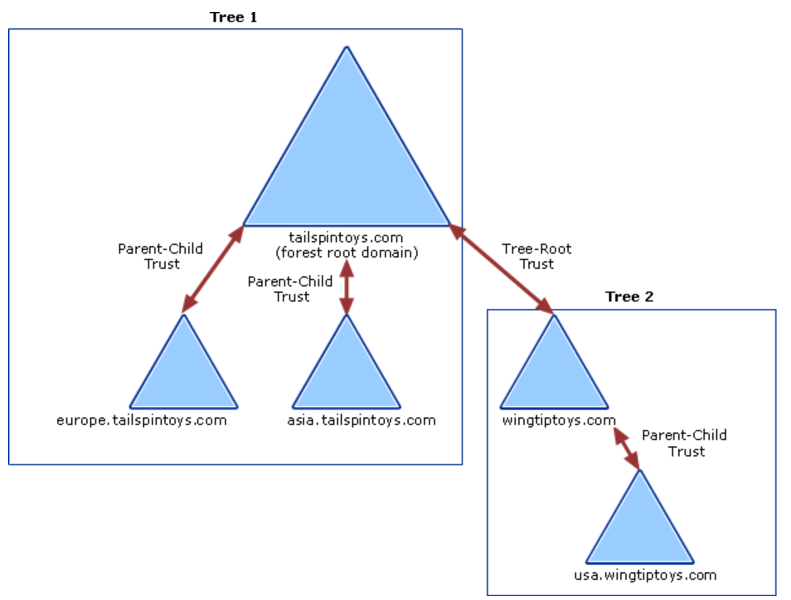
Trust
Types
Within the same forest
Parent-Child trusts
Tree-Root trusts
With other forests
Forest trusts
External trusts
Realm trusts
Options
Sid filtering/Quarantine
Selective Authentication
…
Notes:
This is the bare minimum you need to know about trusts. For the security risks and other security related settings, refer to the module 3 section 1.
Each time you create a new domain in a forest, a two-way, transitive trust relationship is automatically created between the new domain and its parent domain. If child domains are added to the new domain, the trust path flows upward through the domain hierarchy extending the initial trust path created between the new domain and its parent domain. Transitive trust relationships flow upward through a domain tree as it is formed, creating transitive trusts between all domains in the domain tree.
External trust. A nontransitive trust created between a Windows Server 2003 domain and a Windows NT, Windows 2000, or Windows Server 2003 domain in another forest. When you upgrade a Windows NT domain to a Windows Server 2003 domain, all existing Windows NT trusts are preserved intact. All trust relationships between Windows Server 2003 domains and Windows NT domains are nontransitive.
Shortcut trust. A transitive trust between domains in the same domain tree or forest that is used to shorten the trust path in a large and complex domain tree or forest.
Forest trust. A transitive trust between one forest root domain and another forest root domain.
Realm trust. A transitive trust between an Active Directory domain and a Kerberos V5 realm.
Documentation is available here: https://docs.microsoft.com/en-us/previous-versions/windows/it-pro/windows-server-2003/cc773178(v%3dws.10)

Slide 27
Object’s life cycle
When an object is deleted, it is not really deleted…
The object is moved to its local NC Deleted Objects container
It’s stripped of all its non mandatory attributes and we set the attribute isDeleted to TRUE
It stayed there for 60 or 180 days
It depends on the value of the attribute tombstoneLifetime
It leaves the time to replicate the deletion everywhere
It means a DC can not be offline for more than the duration of the tombstoneLifetime
You can’t restore a backup older than the tombstoneLifetime
Notes:
The default value of tombstoneLifetime of a forest depends on the version of the OS of the first domain controller of the forest. It is stored in the configuration partition under CN=Directory Service,CN=Windows NT,CN=Services,CN=Configuration,DC=contso,DC=com and can be changed (note that if the value is not set, the effective time is 60 days).

Slide 28
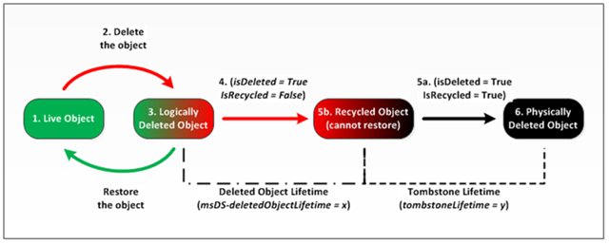
Object’s lifecycle 2.0
But this was in the old days…
If the FFL is Windows Server 2008 R2 and the Recycle Bin feature is enabled, then the object
When an object is deleted, it is moved to its local NC Deleted Objects container
It is NOT stripped of any of its attributes, it is called a “deleted object” (isDeleted = TRUE)
It stays “deleted” (hence restorable) for the 60/180 days (attribute msds-DeletedObjectLifetime)
They it is recycled… which basically means it’s like before the recycle bin (isRecycled = TRUE)

Slide 29
Users, groups, computers
These objects are called security principals
They can be granted permissions on objects and privileges on systems
They have a unique objectSID
We use SID in security descriptors, not names
SID
domain’s SID
object RID
S-1-5-21-1411547893-2725445261-4116970666-1234
AD DS
SECURITY_NT_AUTHORITY
Revision 1
SID
Notes:
Because we use only SID in security descriptors, Windows has a function to translate objectSID to a name and vise versa. This happens under the scene and the resolution gets cached on the local machine. If there is no domain connectivity when you try to display a security descriptor all the ACEs will have SID and not display names (unless these resolutions were previously cached).
The domain SID is unique. It is actually the machine SID of the very first domain controller of the domain.
For more information about LSASS cache for SIDs, you can read the following article: The LsaLookupSids function may return the old user name instead of the new user name if the user name has changed https://support.microsoft.com/en-ca/help/946358

Slide 30
objectSID
Relative IDentifier
The last part of the SID is called RID
An objectSID is domain SID + RID
Each DC has two pools of 500 RIDs
A DC gives the next available RID to the next principal created
RID under 1000 are called well-known RID/SID
RID
Notes:
Each domain controller stores Active Directory account information. This means that, in a network domain, there are as many copies of the account database as there are domain controllers. In addition to this, every copy of the account database is a master copy. New accounts and groups can be created on any domain controller. Changes that are made to Active Directory on one domain controller are replicated to all other domain controllers in the domain. The process of replicating changes in one master copy of the account database to all other master copies is called a multimaster operation.
The process of generating unique relative identifiers is a single-master operation. One domain controller is assigned the role of relative identifier (RID) master, and it allocates a sequence of relative identifiers to each domain controller in the domain. When a new domain account or group is created in one domain controller's replica of Active Directory, it is assigned a SID. The relative identifier for the new SID is taken from the domain controller's allocation of relative identifiers. When its supply of relative identifiers begins to run low, the domain controller requests another block from the RID master.
Each domain controller uses each value in a block of relative identifiers only once. The RID master allocates each block of relative identifier values only once. This process assures that every account and group created in the domain has a unique relative identifier.

Slide 31
.
Video
Video Placeholder
This slide has to be watched with PowerPoint
Notes:
In this video you can see:
An administrator looking at objectSID for a user
An administrator looking at the next RID value
An administrator creating a group and looking at the newly created objectSID

Slide 32
Well-known RIDs and SIDs
SID | Display Name
S-1-5-1 | Dialup
S-1-5-2 | Network
S-1-5-3 | Batch
S-1-5-4 | Interactive
S-1-5-5-X-Y | Logon Session
S-1-5-6 | Service
S-1-5-7 | Anonymous Logon
S-1-5-8 | Proxy
S-1-5-9 | Enterprise Domain Controllers
S-1-5-10 | Self
S-1-5-11 | Authenticated Users
S-1-5-12 | Restricted
S-1-5-13 | Terminal Server User
S-1-5-14 | Remote Interactive Logon
S-1-5-18 | System (or LocalSystem)
S-1-5-19 | LocalService
S-1-5-20 | NetworkService
SID | Display Name
S-1-5-domain-500 | Administrator
S-1-5-domain-501 | Guest
S-1-5-domain-502 | krbtgt
S-1-5-domain-512 | Domain Admins
S-1-5-domain-513 | Domain Users
S-1-5-domain-514 | Domain Guests
S-1-5-domain-515 | Domain Computers
S-1-5-domain-516 | Domain Controllers
S-1-5-domain-517 | Cert Publishers
S-1-5-root domain-518 | Schema Admins
S-1-5-root domain-519 | Enterprise Admins
S-1-5-domain-520 | Group Policy Creator Owners
S-1-5-domain-553 | RAS and IAS Servers
Notes:
Documentation about SIDs and well-known RIDs: https://docs.microsoft.com/en-us/previous-versions/windows/it-pro/windows-server-2003/cc778824(v=ws.10)

Slide 33
Professor Useful
The RID of an object can tell us many things
Very low RID = very old object
Two objects with consecutive RIDs are likely to have been created on the same DC
The RID pool size can change!
By default it is 500… You can make it 1 billion… But don’t…
You can have up to 1 billion RIDs!
Well 1,073,741,823, and up to 2 billion starting Windows Server 2012 (well 2,147,483,647)
Notes:
Additional information about RID depletion and unlocking the 2 billions here: https://blogs.technet.microsoft.com/askds/2012/08/10/managing-rid-issuance-in-windows-server-2012/

Slide 34
Objects and attributes
Objects have a bunch of attributes you would expect
Name, DisplayName, dNShostname, memberOf, manager, city…
Computer and users also have an attribute called userAccountControl
It is a binary mask that enables/disabled options on the account (such as the account is enabled, or the password does not expire, or the account can use DES only for Kerberos etc…)

Slide 35
UAC values
Property flag | Value in hexadecimal | Value in decimal
SCRIPT | 0x0001 | 1
ACCOUNTDISABLE | 0x0002 | 2
HOMEDIR_REQUIRED | 0x0008 | 8
LOCKOUT | 0x0010 | 16
PASSWD_NOTREQD | 0x0020 | 32
PASSWD_CANT_CHANGE | 0x0040 | 64
ENCRYPTED_TEXT_PWD_ALLOWED | 0x0080 | 128
TEMP_DUPLICATE_ACCOUNT | 0x0100 | 256
NORMAL_ACCOUNT | 0x0200 | 512
INTERDOMAIN_TRUST_ACCOUNT | 0x0800 | 2048
WORKSTATION_TRUST_ACCOUNT | 0x1000 | 4096
SERVER_TRUST_ACCOUNT | 0x2000 | 8192
DONT_EXPIRE_PASSWORD | 0x10000 | 65536
MNS_LOGON_ACCOUNT | 0x20000 | 131072
SMARTCARD_REQUIRED | 0x40000 | 262144
TRUSTED_FOR_DELEGATION | 0x80000 | 524288
NOT_DELEGATED | 0x100000 | 1048576
USE_DES_KEY_ONLY | 0x200000 | 2097152
DONT_REQ_PREAUTH | 0x400000 | 4194304
PASSWORD_EXPIRED | 0x800000 | 8388608
TRUSTED_TO_AUTH_FOR_DELEGATION | 0x1000000 | 16777216
PARTIAL_SECRETS_ACCOUNT | 0x04000000 | 67108864
Notes:
The table above lists possible flags that you can assign. You cannot set some of the values on a user or computer object because these values can be set or reset only by the directory service. The flags are cumulative. To disable a user's account, set the UserAccountControl attribute to 0x0202 (0x002 + 0x0200). In decimal, this is 514 (2 + 512).
Full documentation is available here: https://support.microsoft.com/en-us/help/305144

Slide 36
Computers
They also open sessions and do things on the network
They have their own identity, their own account in AD
They have an objectSID
They have a sAMAccountName which their hostname followed by $
You need a computer account for your machine if you want Windows SSO

Slide 37
Groups
You add principals in a group and assign permissions to a group
Groups have objectSID too
There are different types of groups
Security groups: you can use them to give permissions
Distribution groups: you can use them only in a messaging system
Groups also have a scope
Domain local groups: can contain users from anywhere in the forest but can be used only on the domain where it exists
Global groups: can contain users only from the domain where it exists but can be used anywhere in the forest to give permissions
Universal groups: can contains users from anywhere in the forest and can be used to give permissions anywhere in the forest
Notes:
The logic behind group utilisation in a AD DS environment:
AGUDLP (for "account, global, universal, domain local, permission") and AGLP (for "account, global, local, permission")
We add account into a global group, we add global groups into local groups and we use local groups to give permissions on resources.

Slide 38
Password Policy
Passwords are for computers and users
Policies are only for users
By default all users have the same policy
Default Domain Password Policy
With 2008 DF, we can create multiple policies
Fine Grained Password Policies
Then apply those policies to users and/or groups in the domain
Apply stronger policies for privileged accounts
FGPP
Notes:
Policies are evaluated when setting and changing passwords. When the password policy changes after a user changed its password, it will be effective only the next time the password changes.

Slide 39
Password Policy
Policies control the rules for passwords
Minimum password length
Minimum password age
Maximum password age
Password complexity
Password history
Lockout account policy too
How many attempts a user has to login before the account is locked
For how long it is locked, etc.
Notes:
Minimum password length
This sets the minimum number of characters for a password. If you haven’t changed the default setting, you should do so immediately. The default in some cases is to allow empty passwords (passwords with zero characters), which is definitely not a good idea. For security reasons you’ll generally want passwords of at least eight characters because long passwords are usually harder to crack than short ones. If you want greater security, set the minimum password length to 14 characters.
Minimum password age
This determines how long users must keep a password before they can change it. You can use this field to prevent users from bypassing the password system by entering a new password and then changing it right back to the old one. If the minimum password age is set to 0, users can change their passwords immediately. To prevent this, set a specific minimum age. Reasonable settings are from three to seven days. In this way you make sure that users are less inclined to switch back to an old password but are able to change their passwords in a reasonable amount of time if they want to. Keep in mind that a minimum password age could prevent a user from changing a compromised password. If a user can’t change the password, an administrator has to make the change (you can reset a password even if the minimum password age has not been reach yet, this is why resetting passwords is an extended right – see alter in this section about it).
Maximum password age
This determines how long users can keep a password before they have to change it. The aim is to force users to change their passwords periodically. Generally, you use a shorter period when security is very important and a longer period when security is less important. You can set the maximum password age to any value from 0 to 999, where a value of 0 specifies that passwords don’t expire. Although you might be tempted to set no expiration date, users should change passwords regularly to ensure the network’s security. Where security is a concern, good values are 30, 60, or 90 days. Where security is less important, good values are 120, 150, or 180 days. Windows Server 2008 R2 notifies users when the password expiration date is approaching. Any time the expiration date is less than 30 days away, users see a warning when they log on that they have to change their password within a specific number of days.
Password complexity
Beyond the basic password and account policies, Windows Server 2008 R2 includes facilities for creating additional password controls. These facilities enforce the use of secure passwords that follow these guidelines:
- Passwords must have at least six characters.
- Passwords can’t contain the user name or parts of the user’s full name, such as his first name.
- Passwords must use at least three of the four available character types: lowercase letters, uppercase letters, numbers, and symbols.
To enforce these rules, enable the Passwords Must Meet Complexity Requirements policy.
Password history
This sets how frequently old passwords can be reused. With this policy, you can discourage users from alternating between several common passwords. Windows Server 2008 R2 can store up to 24 passwords for each user in the password history. To disable this feature, set the value of the password history to 0. To enable this feature, set the value of the password history using the Passwords Remembered field. Windows Server 2008 R2 then tracks old passwords using a password history that’s unique for each user, and users aren’t allowed to reuse any of the stored passwords. To prevent users from working around the Enforce Password History settings, you should prevent users from changing passwords immediately. This stops users from changing their passwords several times to wipe the history and get back to the old password. You can set the time required to keep a password with the Minimum Password Age policy.
Because of FGPPs, user can have multiple policies associated to them. This is why when you create one you are asked to provide a precedence value. When multiple FGPPs apply to the same use the FGPP with the lower precedence wins. You can use PowerShell to determine what policy applies to a user: Get-ADFineGrainedPasswordPolicySubject https://docs.microsoft.com/en-us/powershell/module/addsadministration/get-adfinegrainedpasswordpolicysubject.
Note that the account lockout policy details will be seen in the next section.

Slide 40
Once upon a time…
Before FGPPs, how can we assigned different policies to different users?
We couldn’t! We had to create a separate domain in the same forest if we wanted to enforce a different password policy.
Or you can trust the admins to use stronger password by diligence.

Slide 41
Default privileged security groups
Enterprise Admins
Schema Admins
Domain Admins
Administrators
Account Operators
Backup Operators
Server Operators
Print Operators
Full control on all naming contexts, but the schema
EA
Full control on the schema naming context
Full control on the domain naming context and all machines
DA
Full control on the domain naming context and all domain DCs
Full control on the users/groups/computers in the domain
Can backup/restore naming contexts
Can control some settings of DCs
Can manage print queues in the domain NC and printers installed locally on DCs
Notes:
AD comes with a bunch of default privileged groups.

Slide 42
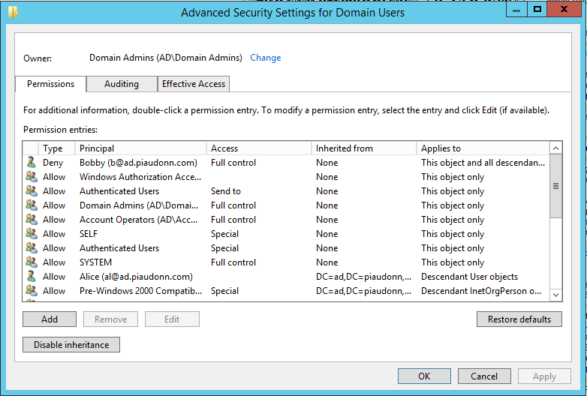
Discretionary
DACL
Each object has a Discretionary Access Control List
It is composed of Access Control Entries
Each ACE has a scope
Ordered in a canonical order
Permissions can be inherited from parent containers
ACE
DACL
(Discretionary Access Control List)
SACL
(System Access Control List also known as Auditing)
ACE
(Access Control Entry)
Notes:
Here is the canonical order of ACE:
1. Access-denied on the object
2. Access-denied on a child or property
3. Access-allowed on the object
4. Access-allowed on a child or property
5. All inherited ACEs
So the permissions set directly on an object takes precedence on those inherited from the parent object. For example, if a user has a deny ACE to modify the email attribute on user at the OU level, but the user has an explicit allow ACE on the object it wants to modify, then the allow ACE takes precedence and the user can modify the email.

Slide 43
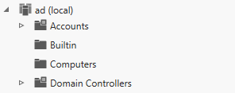

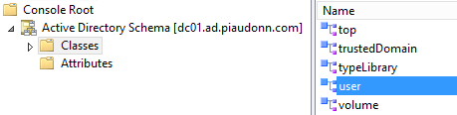
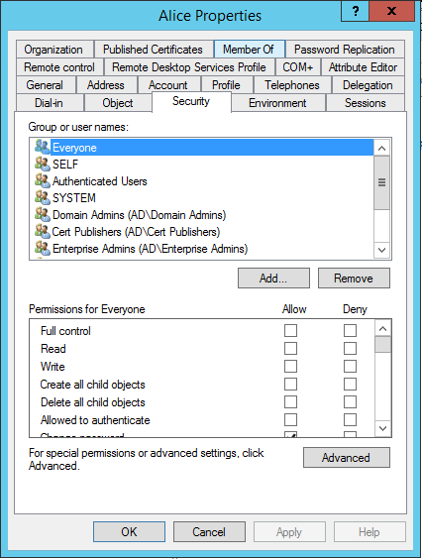
Default Discretionary
defaultSecurityDescriptor
Each class comes with its default DACL which will be applied directly on the object

Slide 44
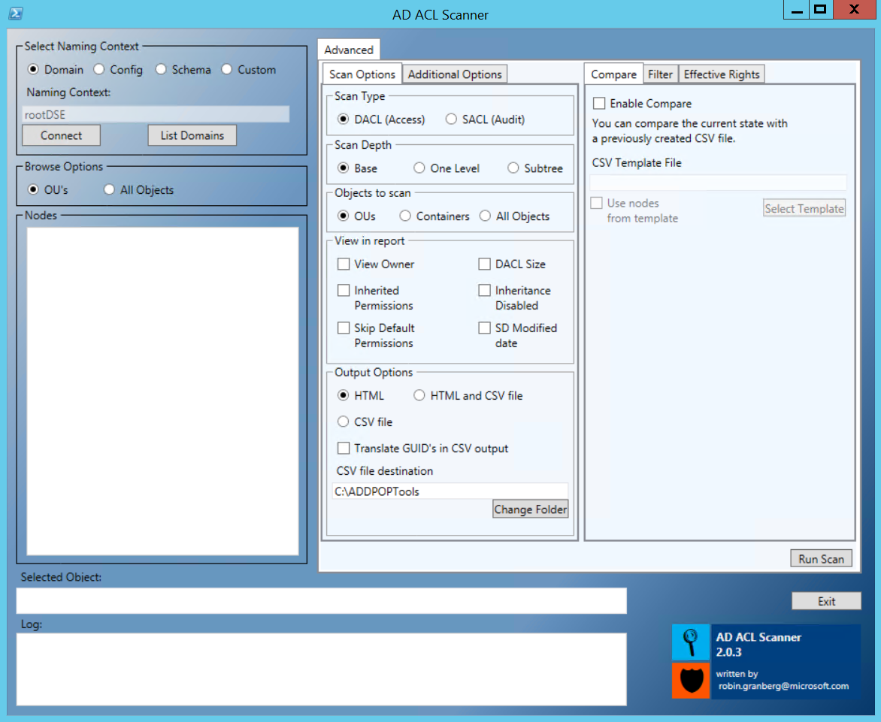
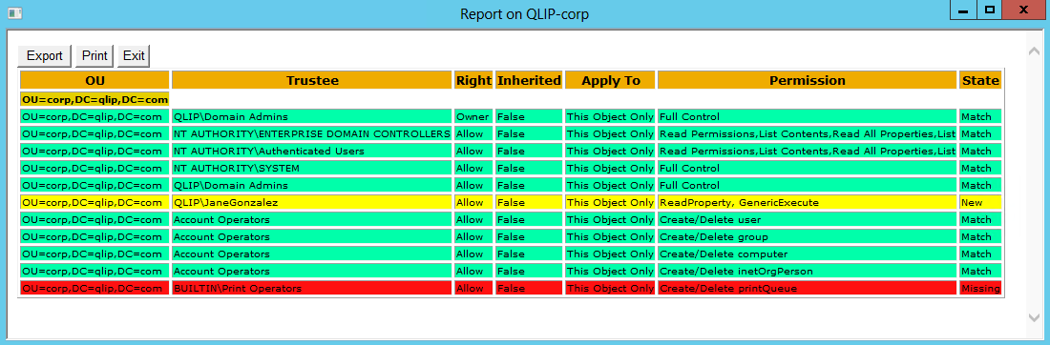
A tool to create reports of permissions in AD
Active Directory ACL Scanner
This is a Windows PowerShell script
Comparison of previous results:
What is new
What is missing
What hasn’t changed
Notes:
Download from: https://github.com/canix1/ADACLScanner

Slide 45
Extended Rights
An ACE usually specifies a class and attributes
An ACE can also be specifying an Extended Right
Permission to perform an “action” against the object on which it is set
The permission to reset a password for example, or the permission to replicate the database…
Notes:
You can list then under: CN=Extended-Rights,CN=Configuration,DC=<Root Domain>
Change Password
Account Restrictions
Change Primary Domain Controller (PDC)
Apply Group Policy
Change Password
Reset Password
Receive As
Send As
Migrate SID History
…

Slide 46
Mad delegation
What if the helpdesk people can reset the password of a domain admin?
The adminSDHolder insures that only AD admins can touch AD admins accounts

Slide 47
adminSDHolder
The DACL of the adminSDHolder is the DACL of all AD admins
All direct members and nested members of default built-in admin groups are protected
Every hour… It: 1. Compares the ntSecurityDescriptor of the objects with the ntSecurityDescriptor of the adminSDHolder object 2. If it is different, then does the following:
Disable the inheritance on the object
Reset the attribute to the adminSDHolder ntSecurityDescriptor value
Set the adminCount attribute to the value 1
Notes:
The actual adminSDHolder object is located under the domain System container (example: CN=AdminSDHolder,CN=System,DC=contoso,DC=com).
It protects certain administrative groups and principals:
DOMAIN_ALIAS_RID_ADMINS
DOMAIN_ALIAS_RID_ACCOUNT_OPS
DOMAIN_ALIAS_RID_SYSTEM_OPS
DOMAIN_ALIAS_RID_PRINT_OPS
DOMAIN_ALIAS_RID_BACKUP_OPS
DOMAIN_ALIAS_RID_REPLICATOR
DOMAIN_GROUP_RID_SCHEMA_ADMINS
DOMAIN_GROUP_RID_ENTERPRISE_ADMINS
DOMAIN_GROUP_RID_ADMINS
DOMAIN_GROUP_RID_CONTROLLERS
DOMAIN_GROUP_RID_READONLY_CONTROLLERS
DOMAIN_USER_RID_KRBTGT
DOMAIN_USER_RID_ADMIN
For more information, see: 3.1.1.6.1 AdminSDHolder - https://msdn.microsoft.com/en-us/library/dd240052.aspx
Note that it does not protect object from other domain. But really, you should not add users from other domains in a privileged groups (unless it is an admin forest, and we will see that in module 3).

Slide 48
Professor Useful
It is possible to unprotect certain groups from the adminSDHolder
The “* Operators” groups could be unprotected
There is one object which is not a security principal but has an objectSID
It is the default Builtin container
It is possible to create dynamic objects in AD
Although not used by any functionality of Windows
It can be used by an attacker to create temporary accounts
Notes:
The built-in container contains at first all groups which were present on the system of the first domain controller before it got promoted.

Slide 49
LDAP
Active Directory does LDAP
LDAP v2 and LDAP v3
On the network, it’s TCP 389 if you want to query information in the default naming contexts
Or you can query the global catalog, it’s on TCP 3268
You cannot change those two ports
The are other APIs available to query AD
SAM-R
WMI
Active Directory Web Services
DNS
And… That’s it about LDAP?

Slide 50
LDAP query 101
Filter
(&(objectClass=user)(userPrincipalName=pierre@contoso.com))
Base
DC=contoso,DC=COM
Scope
Subtree / Base / Onelevel
Attributes
whenCreate,displayName
Notes:
Here are some example of queries in PowerShell (you will find all the parameters of the slides).
All objects with the employeeID sattribute starting with 123:
Get-ADObject -LDAPFilter:"(employeeID=123*)" -Properties:whenCreate,displayName -SearchBase:"DC=contoso,DC=com" -SearchScope:"Subtree" -Server:“dc01.contoso.com“
All enabled users which have not logged in for more than 180 days:
Get-ADObject -LDAPFilter:"(&(objectCategory=person)(objectClass=user)(!userAccountControl:1.2.840.113556.1.4.803:=2)(|(lastLogonTimestamp<=131563872000000000)(!lastLogonTimestamp=*)))" -Properties:whenCreate,displayName -SearchBase:"DC=contoso,DC=com" -SearchScope:"Subtree" -Server:“dc01.contoso.com“
Many examples can be found here: Active Directory: LDAP Syntax Filter https://social.technet.microsoft.com/wiki/contents/articles/5392.active-directory-ldap-syntax-filters.aspx

Slide 51
LDAP query 102
Page Size
A query returns a maximum of 1,000 records (can be changed)
If more than 1,000 are returned, the client has to handle the pages of records (request them, keep track with a cookie and store them)
Timeout
Client and server settings
Referral Chasing
Follow or don’t reference to another naming context
LDAP extensions
SHOW_DELETED Control : 1.2.840.113556.1.4.417
SHOW_RECYCLED Control: 1.2.840.113556.1.4.2064
Notes:
LDAP extensions are specific controls sent to the server to order to retrieve information which are otherwise not returned. For example, if you want to query object which have been deleted, by default they are not returned, hence you have to add the controls mentioned in the slide.
How LDAP Server Cookies Are Handled https://docs.microsoft.com/en-us/windows-server/identity/ad-ds/manage/how-ldap-server-cookies-are-handled

Slide 52
Professor Useful
Optimizing queries
Control GET_STATS: 1.2.840.113556.1.4.970
LDAP Policies
Control the server’s options
How many objects can be returned at once
What’s the time out for LDAP connections
How many threads are used for LDAP queries
One policy for the forest (by default)
Other policies can be created and linked to a specific site or even a specific DC
Notes:
Your DC CPU is running hot? Maybe it is because it’s getting hammered with poorly written LDAP queries… Have a look there then: Creating More Efficient Microsoft Active Directory-Enabled Applications https://msdn.microsoft.com/en-us/library/ms808539.aspx
All you ever wanted to know about LDAP policies is available here: 3.1.1.3.4.6 LDAP Policies https://msdn.microsoft.com/en-us/library/cc223376.aspx

Slide 53
How do I know what LDAP features are available on a DC?
The root directory service entry tells you what is available on a domain controller
RootDSE
Established connection to .
Retrieving base DSA information...
Getting 1 entries:
Dn: (RootDSE)
configurationNamingContext: CN=Configuration,DC=piaudonn,DC=com;
currentTime: 4/6/2018 2:15:15 PM Coordinated Universal Time;
defaultNamingContext: DC=piaudonn,DC=com;
dnsHostName: PIDC01.piaudonn.com;
domainControllerFunctionality: 7 = ( WIN2016 );
domainFunctionality: 7 = ( WIN2016 );
forestFunctionality: 7 = ( WIN2016 );
isGlobalCatalogReady: TRUE;
namingContexts (5): DC=piaudonn,DC=com; CN=Configuration,DC=piaudonn,DC=com; CN=Schema,CN=Configuration,DC=piaudonn,DC=com; DC=DomainDnsZones,DC=piaudonn,DC=com; DC=ForestDnsZones,DC=piaudonn,DC=com;
rootDomainNamingContext: DC=piaudonn,DC=com;
schemaNamingContext: CN=Schema,CN=Configuration,DC=piaudonn,DC=com;
supportedCapabilities (6): 1.2.840.113556.1.4.800 = ( ACTIVE_DIRECTORY ); 1.2.840.113556.1.4.1670 = ( ACTIVE_DIRECTORY_V51 ); 1.2.840.113556.1.4.1791 = ( ACTIVE_DIRECTORY_LDAP_INTEG ); 1.2.840.113556.1.4.1935 = ( ACTIVE_DIRECTORY_V61 ); …
supportedLDAPVersion (2): 3; 2;
…
Notes:
To get this output, once you are interactively connected to a domain controller, or connected on a Windows system with the Active Directory Domain Services administration tools, you can use the following PowerShell cmdlet to Get-ADRootDSE to get a similar output. What is on the slide is a partial view (the full content would not fit).
For a complete list of attribute and their meaning, you can have a look at this documentation: https://msdn.microsoft.com/en-us/library/ms684291(v=vs.85).aspx.

Slide 54
AD is highly available
DCs replicate with each other in a multi-master model
If one DC is not available, others can take up the work
This is a loose consistency model
We don’t commit the change on every DC before validating it
Monitoring replication is critical
We keep track of changes at the attribute level
Replication is following a notify and pull model
When one DC gets a change, it notifies the other DCs, the other DCs will pull for the change
And a store-and-forward for DCs in different geographical locations
We keep track of what we have replicated with whom (state-based replication) to optimize replication traffic
Notes:
Not everything is replicated (remember the schema? Attributes have a flag to mark them replicable)
Multimaster replication
Every domain controller can receive originating updates to data for which it is authoritative, rather than having a single domain controller that receives all original updates (single-master replication, such as Windows NT 4.0 replication).
Provides fault tolerance, eliminating the dependency on a single domain controller to maintain directory operations.
Pull replication
Domain controllers request (pull) changes rather than send (push) changes that might not be needed.
Reduces unnecessary network traffic.
Store-and-forward replication
Each domain controller communicates with a subset of domain controllers to transfer replication changes, rather than one domain controller being responsible for communicating with every other domain controller that requires the change.
Balances the replication load among many domain controllers.
State-based replication
Each domain controller tracks the state of replication updates.
Conflicts and unnecessary replication are reduced.

Slide 55
Replication topology
How do DCs know who to notify?
You define it! You create your site topology
Create sites
Create site links
Create subnets
DCs in the same site are notified within seconds
DCs in a different site are pulling their data according to a defined schedule and interval
All this information is stored in the configuration NC
All DCs are aware of it
France/Canada
24/7
15 mins
contoso.com
Toronto
Paris
192.168.0.0/24
192.168.1.0/24
192.168.2.0/24
eu.contoso.com
Notes:
When a change occurs on a domain controller within a site, two configurable intervals determine the delay between the change and subsequent events:
Initial notification: Initial notification is the length of time between the change to an attribute on a domain controller and the notification of that change to the first partner. This interval serves to stagger network traffic caused by replication. When a domain controller makes a change (originating or replicated) to a directory partition, it starts the timer for the initial notification interval. When the timer expires, the domain controller notifies all of its replication partners (for that directory partition and within its site) that it has changes. The default value for initial notification is 15 seconds.
Subsequent notification: Subsequent notification is the length of time between notification of the first replication partner and notification of each subsequent partner. A domain controller does not notify all of its replication partners at one time. By delaying between notifications, the domain controller spreads out the load of responding to replication requests from its partners. The default delay between notifications is three seconds.

Slide 56
Replication topology
Each DC has a local component called the knowledge consistency checker
It takes care of creating the connection objects for NCs between DCs
Everything is automated (although you can override it)
One DC per site is elected bridgehead for a specific NC
It will handle the inter-site replication according to the site topology defined in the configuration NC
By default the first that shows up, but it can change, and can be overridden
It is decided by the DC who has the role of inter-site topology generator which is the first DC of the site, and can also change
KCC
ISTG

Slide 57
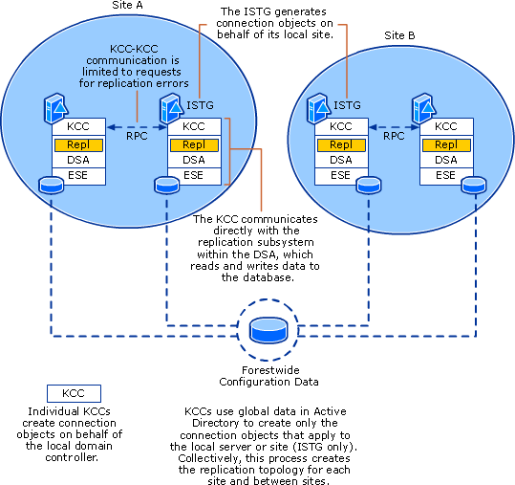
Replication topology (cont.)
Component | Description
KCC | The application running on each domain controller that communicates directly with the Ntdsa.dll to read and write replication objects
Directory System Agent (DSA) | The directory service component that runs as Ntdsa.dll on each domain controller, providing the interfaces through which services and processes, such as KCC, gain access to the directory database
Extensible Storage Engine (ESE) | The directory service component that runs as Esent.dll. ESE manages the tables of records, each with one or more columns. The directory database is composed of the tables of records
Remote Procedure Call (RPC) | The Directory Replication Service (DRS) (Drsuapi) RPC protocol is used to communicate replication status and topology to a domain controller. The KCC also uses this protocol to communicate with other KCCs to request error information when building the replication topology
Inter-Site Topology Generator (ISTG) | The single KCC in a site that manages intersite connection objects for the site

Slide 58
Once upon a time…
Urgent replication!
Back in the Windows 2000 Server days, the default delay for notifications for DCs within the same site was up to 5 minutes
To bypass this, changes in the NC that have a security impact were bypassing the delay and replicating urgently (account lockout for example)
It does still exist, but now that intra-site delays are just a few seconds, the urgent flag does not change things much
Note that urgent replication never crosses site-links, in other words, when an account is locked-out for example, this is replicated right away on all DCs of the same site, but will wait for the interval/schedule for inter-site
Notes:
Events That Trigger Urgent Replication Urgent Active Directory replication is always triggered by certain events on all domain controllers within the same site. When change notification has been enabled between sites, these triggering events also replicate immediately between sites. Immediate notification between domain controllers in the same site is prompted by the following:
An account lockout, which a domain controller performs to prohibit a user from logging on after a certain number of failed attempts
Changing the account lockout policy
Changing the domain password policy
Changing a LSA secret, which is a secure form in which private data is stored by the LSA (for example, the password for a trust relationship)
Changing the password on a domain controller account
Changing the RID master role owner, which is the single domain controller in a domain that assigns relative identifiers to all domain controllers in that domain

Slide 59
.
Video
Video Placeholder
This slide has to be watched with PowerPoint
Notes:
In this video you can see:
An administrator browsing the Sites and Services console
An administrator looking at replication logs (repadmin and PowerShell) AND APRelMon (GUI)

Slide 60
Keeping track of things
Because we replicate at the attribute level, we need to keep track of at least two things
Did something change on the database of a domain controller
If yes, what attribute changed
For the first one we have Update Sequence Numbers
It’s a counter incremented by 1 at each change
Each DC has its own counter
DCs know what is the USN of each other to keep track if they already replicated a change
For the second, we have replication metadata
It tracks from where an attribute has been changed (DC and USN)
It tracks when and how many times the value has changed
USN

Slide 61
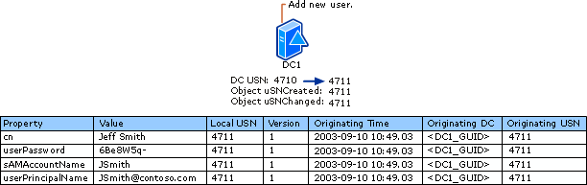
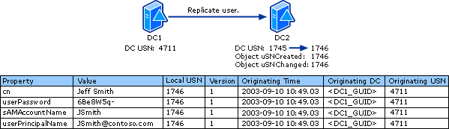
The replication protocol in detail
Object Creation
Object replication

Slide 62
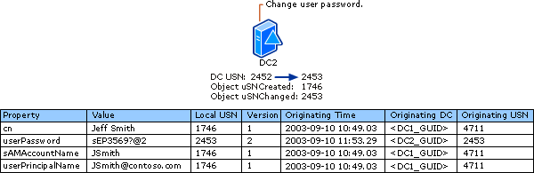
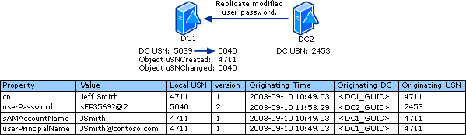
The replication protocol in detail
Object modification
Object replication

Slide 63
Up-to-date Vector and High Watermark
Up-to-date Vector is for tracking originating updates
Determines attributes to send for replication
For each domain controller that holds a full replica of the partition. It holds the following:
Database GUID (invocation ID) of source domain controller
Highest-originating-USN from source domain controller
Timestamp from last successful replication (Windows Server 2003)
If the destination already has an up-to-date value, the source domain controller does not send the update
High Watermark determines objects to consider for replication
Table on each domain controller that contains entries for direct replication partners and the highest known USN from those partners (uSNChanged)
Destination provides value to source
Source filters changes that do not need to be sent

Slide 64
Inter-site replication
To control inter-site replication, you need to create site-links
You assigned the sites you want to link
You assign a weight
You assign an interval and a schedule
Site-links can be transitive
If you enable the option called Bridge All Site Links
And if you trust your network, you can enable “notifications” on a site-link
In that case, BHs of the sites included in the site links will replicate like they were in the same site (ignore the inter-site interval and the schedule)
Notes:
All these operations can be done in command line or with the Sites and Services default console.

Slide 65
.
Video
Video Placeholder
This slide has to be watched with PowerPoint
Notes:
In this video you can see:
An administrator looking at USN and replication metadata

Slide 66
Multimaster, advantages and drawbacks
If you install DNS on a DC, the DNS zone can also be multi-master
We spoof the Start of Authority
What if the same object is changed on two DCs at the same time?
Most conflicts are avoided (attribute level replication), some of them are automatically resolved (name conflicts, orphaned objects) and some of them are avoided thanks to flexible single master operation DCs.
SOA
Replication conflicts!
Flexible what?
FSMO
Notes:
We spoof the SOA? What does that mean?
In the DNS world, we are in a mono-master model. One NS server is referenced in the SOA (Start of Authority) record. Modification can only be done on this NS server. So if a client needs to register it’s A (or PTR) record, it firsts ask its DNS server who is the SOA for a zone and the DNS server replies with the NS server which is Read/Write. Then the client sends its update to that NS server. When we integrate the DNS zone in AD, they are all read/write. In order to achieve this, when a client ask a DC/DNS server the SOA record, the DC/DNS server always answer that it is itself (SOA spoofing). Therefore, the client updates will be send to its local DC.

Slide 67
Let’s clarify
Some replication conflicts might be crippling
Two administrators modifying the schema in two different DCs at the same time!
Two administrators picking the same name for a new domain in the forest
Two DCs creating the same SID for two security principals
Two GPO modified on two DCs
There is another one, but its importance faded away with Windows Server 2008 R2 FFL
The infrastructure master… See the notes section.
Schema master, one per forest
Domain naming master, one per forest
RID master, one per domain
PDC emulator, one per domain
Notes:
Those scenarios are not possible because FSMO holders ensure this can be done only in one place.

Slide 68
Flexible Single Master Operation, cont.
First come, first served
The first DC of the forest has all the forest roles
The first DC of the domain has all the domain roles
They can be transferred
They can be seized (if a DC crashed, you can have another DC take over the role)
The ePDC is special
Originally designed to hold the role of Primary Domain Controller when migrating from a Windows NT domain, it ended up with so many other responsibilities: - it is the NTP time reference in the forest - all password changes are channeled back to it immediately - all failed authentications are channeled back to it too
As a result, it is busier, and might need more physical resources (memory and CPU)
PDC
Notes:
We say PDC but what we mean is ePDC. PDCs do not exist post NT4. All DCs are read/write. But everybody referes to it as the PDC.

Slide 69
Professor Useful
NTDSUTIL.EXE
Can be used to transfer or seize FMSO roles
Can be used to do file operations on the database (such as integrity checks or offline defragmentation…)
Can be used to set the recovery password (the one you can use to login into a DC in a recovery scenario, so when the database is not up and running)
RootDSE operations
Many of the operations performed with NTDSUTIL can be done via LDAP using RootDSE modifications
These operations require a high level of privileges

Slide 70
Where do we store all that data again?
NTDS.dit
The actual database
EDB.log
Some transaction logs
EDBxxxxx.log
EDB.chk
RES1.log & RES2.log
Placeholder files to ensure we can write logs and shut down the database gracefully when there is a disk space issue.
Temp.edb
Notes:
The place of these files are decided at promotion time. They can be moved somewhere else on the server using the utilize NTDSUTIL.
By default they are in C:\Windows\NTDS. If you do not find it, check the registry HKEY_LOCAL_MACHINE\SYSTEM\CurrentControlSet\Services\NTDS\Parameters for the two values “DSA Database file” and “Database log files path”.
Ntds.dit
Ntds.dit is the main AD database file. NTDS stands for NT Directory Services. The DIT stands for Directory Information Tree. The Ntds.dit file on a particular domain controller contains all naming contexts hosted by that domain controller, including the Configuration and Schema naming contexts. A Global Catalog server stores the partial naming context replicas in the Ntds.dit right along with the full Domain naming context for its domain.
Edb.log
Edb.log is a transaction log. Any changes made to objects in Active Directory are first saved to a transaction log. During non-peak times in CPU activity, the database engine commits the transactions into the main Ntds.dit database. This ensures that the database can be recovered in the event of a system crash. Entries that have not been committed to Ntds.dit are kept in memory to improve performance. Transaction log files used by the ESE (Extensible Storage Engine is an Indexed Sequential Access Method (ISAM) data storage technology from Microsoft. ESE is the core of Microsoft Exchange Server and Active Directory.) engine are always 10MB.
Edbxxxxx.log
These are auxiliary transaction logs used to store changes if the main Edb.log file gets full before it can be flushed to Ntds.dit. The xxxxx stands for a sequential number in hex. When the Edb.log file fills up, an Edbtemp.log file is opened. The original Edb.log file is renamed to Edb00001.log, and Edbtemp.log is renamed to Edb.log file, and the process starts over again. Excess log files are deleted after they have been committed. You may see more than one Edbxxxxx.log file if a busy domain controller has many updates pending.
Edb.chk
Edb.chk is a checkpoint file. It is used by the transaction logging system to mark the point at which updates are transferred from the log files to Ntds.dit. As transactions are committed, the checkpoint moves forward in the Edb.chk file. If the system terminates abnormally, the pointer tells the system how far along a given set of commits had progressed before the termination.
Res1.log and Res2.log
Res1.log and Res2.log are reserve log files. If the hard drive fills to capacity just as the system is attempting to create an Edbxxxxx.log file, the space reserved by the Res log files is used. The system then puts a dire warning on the screen prompting you to take action to free up disk space quickly before Active Directory gets corrupted. You should never let a volume containing Active Directory files get even close to being full. File fragmentation is a big performance thief, and fragmentation increases exponentially as free space diminishes. Also, you may run into problems as you run out of drive space with online database defragmentation (compaction). This can cause Active Directory to stop working if the indexes cannot be rebuilt.
Temp.edb
This is a scratch pad used to store information about in-progress transactions and to hold pages pulled out of Ntds.dit during compaction.
Information taken from: https://blogs.msdn.microsoft.com/servergeeks/2014/10/14/active-directory-files-and-their-functions/
More about ESE storage technology: https://msdn.microsoft.com/en-us/library/gg269259%28v=exchg.10%29.aspx

Slide 71
Once upon a time…
Physical disks
Back in 2000, disk perf were not what they are now… So there were plenty of ways to optimize disk performance (use different disks for the database and the logs, use different RAID technology…)
Nowadays, performance when the database and the logs are on the same disk is acceptable.
Notes:
ESE was formerly known as Joint Engine Technology (JET) Blue, and so frequently the term "JET Blue" or "JET" is used interchangeably with the term ESE outside this documentation. However, there are in fact two completely separate implementations of the JET API, called JET Blue and JET Red. The term "JET" is frequently also used to refer to JET Red, which is the database engine that is used with Microsoft Office Access. The two JET implementations are completely different, are separately maintained, have a vastly different feature set, and are not interchangeable. Within the ESE documentation, "JET" refers to the ESE or the JET API as ESE implements it. Any references to the JET Red will always explicitly be labeled "JET Red".

Slide 72
Back to the future
NTDS snapshots
You can take snapshots of the NTDS.dit database and mount them on an alternate port to be able to query the previous state of the hosted naming contexts.
You can create snapshots with NTDSUTIL or directly with the VSS utility
Notes:
Note that NTDS snapshots and VSS snapshots are different from virtual machine snapshots.

Slide 73
.
Video
Video Placeholder
This slide has to be watched with PowerPoint
Notes:
In this video you can see:
An administrator creates and mounts a snapshot
An administrator uses DSA.msc to check data

Slide 74
Hey dude, where’s my DC?
This is where the love story between AD and DNS unravels
Windows clients will use DNS to find the closest domain controller
It is a Windows service responsible for this: netlogon
For non Windows clients, the logic has to be implemented either at the OS or at the application level
Hardcoded systems (to IPs or names) will be impacted by DC downtime. Windows clients will just find another one automatically thanks to their netlogon service
The high availability is implemented at the client level. Not at the network level!
Notes:
The high availability is implemented at the client level. Not at the network or server level!
In other words, there is no network layer load balancing in front of domain controllers. The client is in charge of finding the closest DC and to pick another one if the one it already picked is unresponsive and/or another DC with better connectivity becomes available.

Slide 75
May the best DC win!
When a DC starts, its netlogon service registers DNS records
When a domain-joined machine is looking for a DC, its netlogon service queries DNS
From those DNS responses, the client will select the first X and perform what is often referred to as an “LDAP ping” with specific flags (like I am looking for a reliable time source, or for a Windows Server 2012 R2 DC)
The first one who answers with the right flag is selected
The result is cached for 12 hours (unless the DC becomes unresponsive)
Notes:
Note that the “LDAP ping” has nothing to do with ICMP, just a connectivity test on the port UDP 389 of the DC.

Slide 76
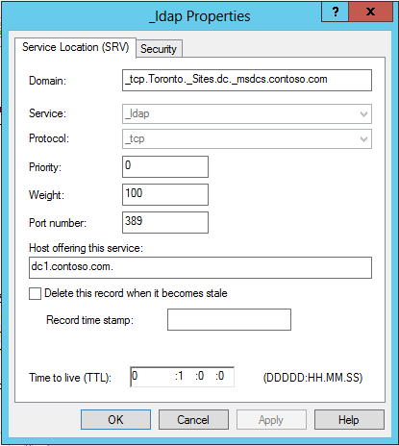
SRV records and closest DC discovery
A DC belongs to a site
The operator can chose which site or rely on subnet/site association in any
Clients also belong to a site
Dynamically thanks to their subnet/site association
Can also be overwritten
Everything takes place through DNS queries
What does an SRV record look like?
It has a service, a protocol, a priority, a weight and a port
Those two help a client to pick the best DC
Notes:
RFCs for SRV: 2782 2052

Slide 77

DsGetDcName in a nutshell phase 1
Site specific records
_ldap._tcp.Toronto._Sites.dc._msdcs.contoso.com. = dc1
_kerberos._tcp.Toronto._Sites.dc._msdcs.contoso.com. = dc1
…
Registers in DNS
Siteless or generic records
_ldap._tcp.dc._msdcs.contoso.com. = dc1
_kerberos._tcp.dc._msdcs.contoso.com. = dc1
…
dc1
NETLOGON.EXE
SRV records
netlogon.dns
Notes:
DsGetDcName is the actual name of the function Netlogon uses to get the FQDN of a domain controller.
The list of all DNS records created by a domain controller is available in a log file on the DC itself in C:\Windows\System32\Config\netlogon.dns.

Slide 78

DsGetDcName in a nutshell phase 2
Site specific records
_ldap._tcp.Toronto._Sites.dc._msdcs.contoso.com. = dc1
_kerberos._tcp.Toronto._Sites.dc._msdcs.contoso.com. = dc1
…
Siteless or generic records
_ldap._tcp.dc._msdcs.contoso.com. = dc1
_kerberos._tcp.dc._msdcs.contoso.com. = dc1
…
win10
IP = 1.0.0.1 Site = ?
Notes:
When a machine is joining the domain, it doesn’t know yet what site it belongs to. As a result, it will query generic record and get any DC available for the operation.
Once it contacted one DC, the DC answer what is the site of the client (thanks to its IP address) and from now on, the client will use a specific site for tis DNS queries.

Slide 79
DsGetDcName in a nutshell phase 3
Site specific records
_ldap._tcp.Toronto._Sites.dc._msdcs.contoso.com. = dc1
_kerberos._tcp.Toronto._Sites.dc._msdcs.contoso.com. = dc1
…
Siteless or generic records
_ldap._tcp.dc._msdcs.contoso.com. = dc1
_kerberos._tcp.dc._msdcs.contoso.com. = dc1
…
win10
IP = 1.0.0.1 Site = Toronto
Notes:
Now the clients know where to go for domain controller. And one every 12 hours, the client will query again _ldap._tcp.Toronto._Sites.dc._msdcs.contoso.com. to make sure the current DC it uses still makes sense.

Slide 80
Once upon a time…
Sticky DCs
Windows 2000 Server, Windows XP, Windows Server 2000 discovered DCs only if the one they already selected is unresponsive. They did not check if better DCs were available every 12 hours
Dynamic updates
It is preferred that the DNS server hosting the zone supports dynamic updates. Else the SRV records have to be manually maintained.
And yep, back in the days, it was common to find BIND implementations for which the dynamic updates were not available or not configured

Slide 81
Secure Channel
The Netlogon service is also responsible to build and maintain a secure connection with its local domain controller
This connection is called the secure channel
It enables the local system to talk to a domain controller in a secure way (to resolve SIDs for example)
Domain controllers also have secure channels
When DCs need to resolve SID from another domain for example, they can build a secure channel with a DC from another domain
Notes:
To see what DC a system used for its secure channel:
C:\>nltest /SC_QUERY:contoso.com
Flags: 30 HAS_IP HAS_TIMESERV
Trusted DC Name \\dc01.contoso.com
Trusted DC Connection Status Status = 0 0x0 NERR_Success
The command completed successfully

Slide 82
Group Policy Objects 101
GPO
Group Policy Object infrastructure
Offers a centralized way to control configuration aspects of machines and user’s environment
They have a machine section and a user section.
The machine section applies to the machine and the user section applies to the user.
Examples: control the Windows security settings, the local group memberships, the states of Windows services, configure Windows components, customize the user’s desktop experience, configure user’s applications…
GPOs are applied at boot time and logon time and then reapplied at regular intervals
GPOs can be linked to sites, domains and OUs
GPOs are uniquely identified by a GUID
Two GPOs have well-known GUID: Default Domain Policy and Default Domain Controller Policy
DDP
DDCP
Notes:
Although GPO are uniquely identifies by a GUID, and GUID are supposed to be always different, two GPOs always have the same GUID in every AD DS deployment. The “Default Domain Policy” and “Default Domain Controller Policy” exist by default in all AD deployment and always have the same GUID.
- Default Domain Policy: {31B2F340-016D-11D2-945F-00C04FB984F9}
- Default Domain Controller Policy: {6AC1786C-016F-11D2-945F-00C04FB984F9}
These GUID are hardcoded so Microsoft applications which need to modify the domain settings or domain controllers settings can do it with minimal effort.

Slide 83
Group Policy Objects 101
Domain components
The group policy container
Is stored in the domain NC and contains information such as the display name
The group policy template
The actual files containing the settings
The WMI filter
A way to limit the application of a GPO only to systems where a WMI query returns something
The GPO link
Indicates which GPOs are linked to a site, domain or OU
A security descriptor (set of permissions)
GPOs have a DACL
An account needs the Read and the Apply permissions to download and apply the settings
GPC
GPT
Notes:
All GPC are stored in the domain System container (example: CN=Policies,CN=System,DC=contoso,DC=com).
The GPT are stored in SYSVOL (example: \\contoso.com\sysvol\contoso.com\Policies\{0A0AA835-66DA-4576-BCE4-B825B7D1772F} for the GPO with the matching GUID).
Objects which can have a GPO linked to them have a gPLink attribute.

Slide 84
Group Policy Objects 101
Client components
Windows service
Client side extensions
The DLL on the system in charge of applying the settings
CSE

Slide 85
Group policy application
Composed of two phases
Build a list of GPO by listing all gPLink attribute
Evaluate if the GPO applies (permission Read+Apply and WMI filters evaluation)
Enumerate all CSE needs to apply the settings
Load the corresponding DLLs
Apply the settings
Download the settings and give the data to the CSE to be applied
Refresh takes place every 90 minutes
Plus a random timer of -30/+30 minutes to avoid flooding DC
It is actually every 5 minutes on a domain controller
This can be adjusted
Resultant set of policy can be used to see what happened
RSOP
Notes:
The refresh timing can be changed (it is a group policy setting to change the group policy behavior!).
In order to determine what has been done by the group policy engine on a system, you can invoke the RSoP engine. The easiest way to do it is to run the command:
GPRESULT /H C:\TEMP\RSOP.HTML
In order to get the computer’s RSOP data, make sure you run this command as an admin.

Slide 86
Why not give the admin password to everyone?
GPP
Group Policy Preferences
New set of CSE to extend the GPO functionalities
It’s very practical! (you can write registry values, create shortcuts, configure IE…)
But some of these component allow an administrator to store a password in the GPP file
Because GPO settings are stored in SYSVOL and that everyone can read SYSVOL, if you use one of these settings, you effectively give your password to everyone. So be careful!
Wait what? Clear-text passwords in SYSVOL?
To be fair, it is not in the clear. It is encrypted. But the decryption key is public…
Notes:
Security update to prevent the use of the unsecure settings in GPP: https://support.microsoft.com/en-us/help/2962486/ms14-025-vulnerability-in-group-policy-preferences-could-allow-elevate
Decryption key for GPP encryption: https://msdn.microsoft.com/en-us/library/2c15cbf0-f086-4c74-8b70-1f2fa45dd4be.aspx

Slide 87
System Volume Information
Stores the actual GPO settings
Stores GPO templates
Also replicates, but using a different protocol: DFSR
Block level replication (optimize network traffic)
Robust protocol and manage retry/conflict resolutions pretty well
SYSVOL has a ReplicationGroup
DCs have a subscription to replicate it
It is configured automatically, nothing has to be done for it to work

Slide 88
Once upon a time…
The NETLOGON folder
To ensure a smooth transition between the NT domain and Windows 2000 Server, the shared folder NETLOGON was kept on domain controllers. It was intended to store logon scripts in the meantime they got into GPO.
It is fairly common to see that this folder is still used to store a lot of things… Some of those files might also carry some clear-text passwords. Why not?
FRS replication
Up to Windows Server 2008 R2, the legacy File Replication System was used to replicate SYSVOL
Well, it has aged… And despite all its flaws, you might still run into it in old environments (if so, please migrate!)
Notes:
Guide for SYSVOL migration: https://docs.microsoft.com/en-us/previous-versions/windows/it-pro/windows-server-2008-R2-and-2008/dd640019(v=ws.10)
About FRS: Windows Server 2016 RS1 is the last version that will allow FRS – RS3 no longer includes the binaries. https://support.microsoft.com/en-us/help/4025991/windows-server-2016-rs3-no-longer-supports-frs

Slide 89
How to say good bye to a DC?
You can remove the AD DS component from a server
When done gracefully (via PowerShell or the Server Manager) it removes all the necessary objects
You need to transfer the FSMO roles to other DCs (if it hosts some)
What if my DC crashed and I cannot remove it gracefully?
You can use the metadata cleanup process, it will remove all the necessary objects and references
This can be done graphically with the built-in consoles
This can be done in command line with the tool NTDSUTIL
Do not recycle DCs
Once they are demoted, destroy them
Notes:
Ref: How to remove data in Active Directory after an unsuccessful domain controller demotion https://support.microsoft.com/en-us/help/216498/how-to-remove-data-in-active-directory-after-an-unsuccessful-domain-co

Slide 91
List of abbreviations
DC Domain Controller
SSO Single Sign-On
DIR Directory Information Tree
DFL Domain Functional Level
FFL Forest Functional Level
NC Naming Context
DN Distinguished Name
RDN Relative Distinguished Name
CN Common Name
OU Organizational Unit
GUID Global Unique Identifier
GC Global Catalog
SID Security Identifier
RID Relative Identifier
FGGP Fine Grained Password Policy
EA Enterprise Admins
DA Domain Admins
ACE Access Control Entry
DACL Discretionary Access Control List
SACL System Access Control List
KCC Knowledge Consistency Checker
ISTG Inter-Site Topology Generator
USN Update Sequence Number
FSMO Flexible Single Master Operation
PDC Primary Domain Controller
GPO Group Policy Object
DDP Default Domain Policy
DDCP Default Domain Controller Policy
GPC Group Policy Container
GPT Group Policy Template
CSE Client Side Extension
RSOP Resultant Set of Policy
GPP Group Policy Preference

